Slide 1


Merck Challenge:
RF VIM
Final Review
Daniel Wang | Pratiksha Sharma | Niharika Krothapalli

Slide 2




Meet the Team
Daniel Wang Rutgers MSDS
Pratiksha Sharma Rutgers MSDS
Niharika Krothapalli Rutgers MSDS

Slide 3
Outline
Introduction to Problem
Background on RF & RF VIM
Methodology – Data & Packages Used
Discussion of Results + Framework
Future Work

Slide 4
Introduction
1.
Random Forest VIM methods exploration and evaluating various Random Forest VIM methods on real time data sets.
Clinical records collected pertaining to Heart Failure
13 Predictors ~ DEATH_EVENTS
Four simulated data sets
10 Predictors ~ Y
Developing a structural procedure with which to approach VIM evaluation

Slide 5

Background
2.
Random Forest
Ensemble Classifier with many decision trees and outputs class is based on the frequency of the class’s output by individual trees.
Variable Importance Measures (VIM)
RF predictor set is high-dimensional, resulting in incorrect bias variance trade-off for individual importance measure
Gini VIM
Permutation VIM
Conditional Permutation VIM

Slide 6
Methodology
3.
Exploring the different packages we used

Slide 7
PYTHON

Slide 8
Scikit-learn
Suitable for both classification and regression
Usage of RandomForestClassifier and the RandomForestRegressor classes which contain methods to create random forest models and evaluate their VIMs based on Mean Decrease in Impurity (MDI).
Additional usage of permutation importance method from sklearn inspection package.

Slide 9
R

Slide 10
VarImp (R)
Suitable only for classification
Usage of Conditional Random Forests from the ‘party’ package in R for model creation
Three main functions namely - varImp, varImpACC and varImpAUC used for calculation of variable importances

Slide 11
VarImp (R)
All three functions are capable of measuring variable importances conditionally and non-conditionally.
varImp can perform classical PI and CPI
varImpACC takes into account the accuracy of results/predictions made by the model
varImpAUC takes area under the curve as a consideration while computing variable importances

Slide 12
randomForest
Build random forest model
Comes with Mean Decrease in Impurity & Mean Decrease in Accuracy
Uses Gini impurity and permutation importance

Slide 13
permimp
Implements conditional permutation importance
Uses Chi-squared test to determine non-independent factors
Partition data to find conditional importance

Slide 14
randomForestExplainer
Creates importance frame which contains a plethora of variable importance measures
Can visually compare techniques and evaluate accordingly

Slide 15
Results
4.
Comparing the results between the packages and coming up with a framework

Slide 16
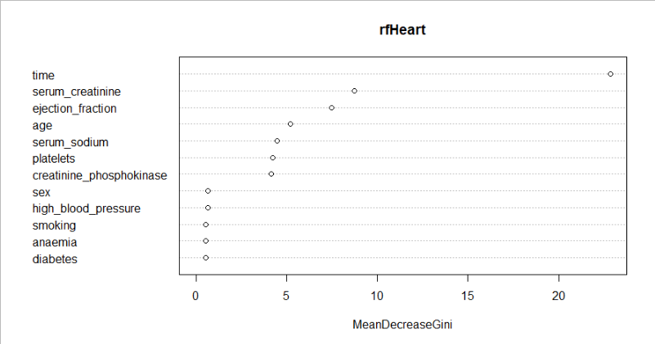
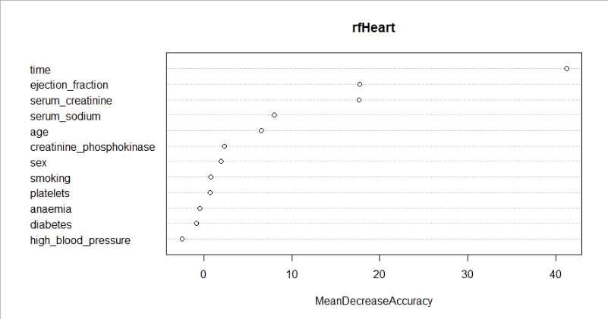
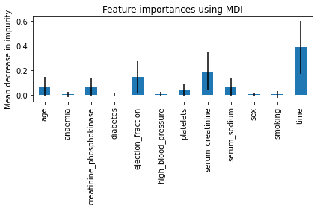
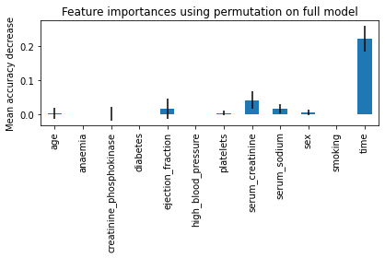
Mean Decrease in Impurity vs. Mean Decrease in Accuracy

Slide 17
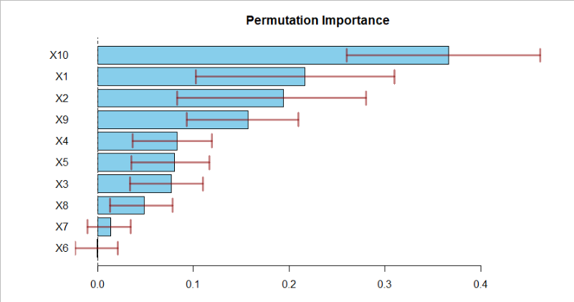
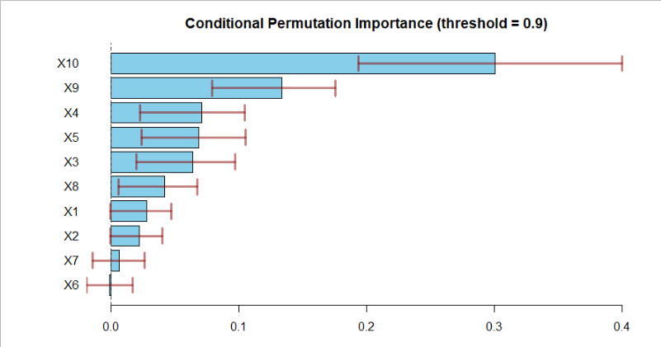
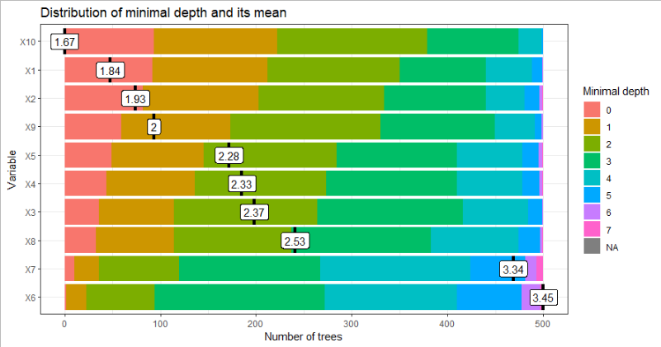
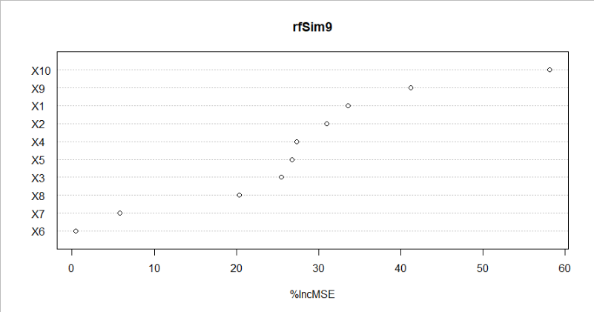
Simulation 0.9 Graphs

Slide 18
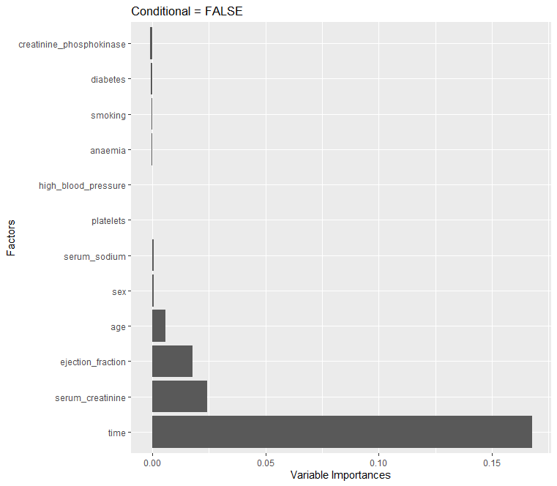
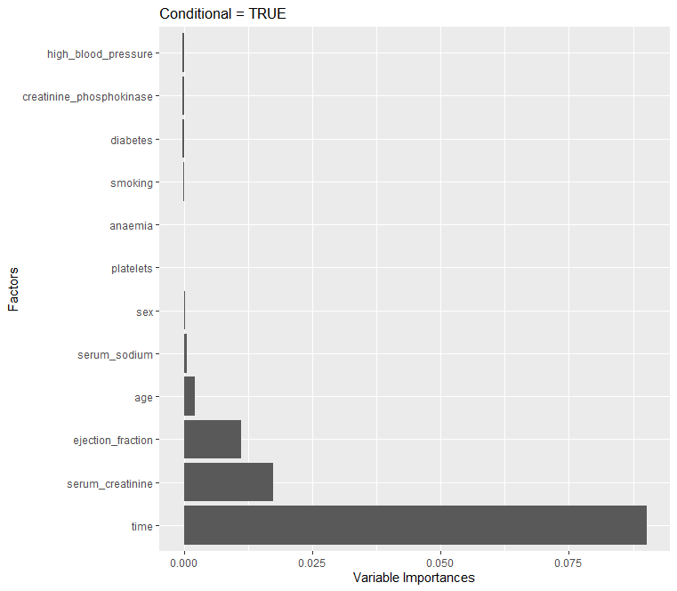
user system elapsed
2.96 0.00 2.96
user system elapsed
80.12 0.12 80.90
Heart Failure Dataset PI vs. CPI (varImpAcc) tradeoff between time of computation and magnitude of differences in ranking

Slide 19
Framework
Data cleaning and pre-processing for random forest model creation
Check the correlation table across all of your variables
Try all other measures available, and take note of key differences
1
3
5
2
4
6
Create your random forest model using all of the variables
In case of high correlation, use conditional permutation importance
Fine tune model or data accordingly

Slide 20
Simulated Dataset
Up Next: Data is generated using simulations
Check the correlation table across all of your variables
Try all other measures available, and take note of key differences
1
3
5
2
4
6
Create your random forest model using all of the variables
In case of high correlation, use conditional permutation importance
Fine tune model or data accordingly

Slide 21
Simulation Data
x1 | rnorm(500,0,2), rnorm(500,3,2)
x2 | rnorm(500,0,2), rnorm(500,3,2)
x3 | rnorm(500,0,2.1), rnorm(500,3,2.1)
x4 | x3 + rnorm(1000,0,0.2)
x5 | rnorm(500,0,2.1), rnorm(500,3,2.1)
x6 | x5 + rnorm(1000,0,1.5)
x7 | rnorm(500,0,2.1), rnorm(500,3,2.1)
x8 | x7 ** 2 + c(rnorm(1000,0,0.2))
x9 | x4 + x6 + x8
x10 | rnorm(1000)

Slide 22
Simulated Dataset
Data is clean and prepared
Check the correlation table across all of your variables
Try all other measures available, and take note of key differences
1
3
5
2
4
6
Up next: Creating a random forest and conditional random forest model in R
In case of high correlation, use conditional permutation importance
Fine tune model or data accordingly

Slide 23
Model Specifications
randomForest
We used the randomForest function to create a randomForest using node size 7 for our simulated data.
This object is then further passed to functions from different packages like permimp and randomForestExplainer to measure variable importances.

Slide 24
Model Specifications
party
We used the cforest function to create a conditional forest with default values for our simulated data.
This object is then passed to functions from the varImp package like varImp, varImpACC and varImpAUC to measure variable importances.

Slide 25
Simulated Dataset
Data is clean and prepared
Up next: Check correlation between variables in the dataset
Try all other measures available, and take note of key differences
1
3
5
2
4
6
randomForest and cforest models have been created
In case of high correlation, use conditional permutation importance
Fine tune model or data accordingly

Slide 26
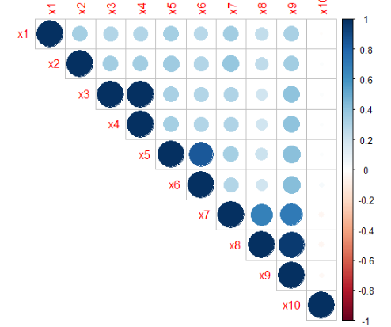
Correlation Plot: Shows high correlation between multiple variables

Slide 27
Simulated Dataset
Data is clean and prepared
High correlation between variables discovered
Up next: computation of VIMs considering other PI measures
1
3
5
2
4
6
randomForest and cforest models have been created
Up next: computation of VIMs considering CPI
Fine tune model or data accordingly

Slide 28
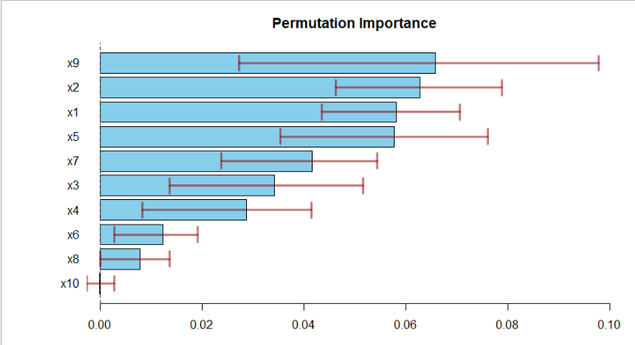
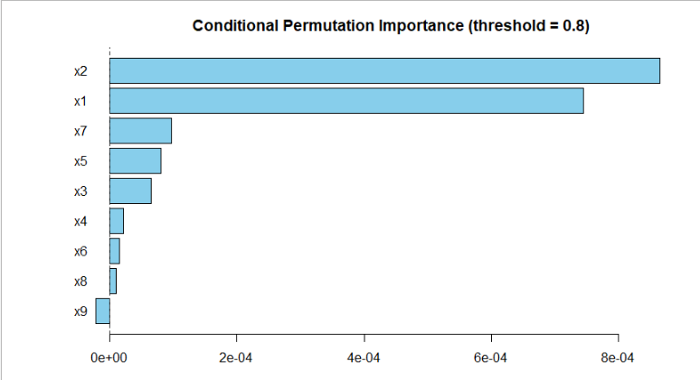
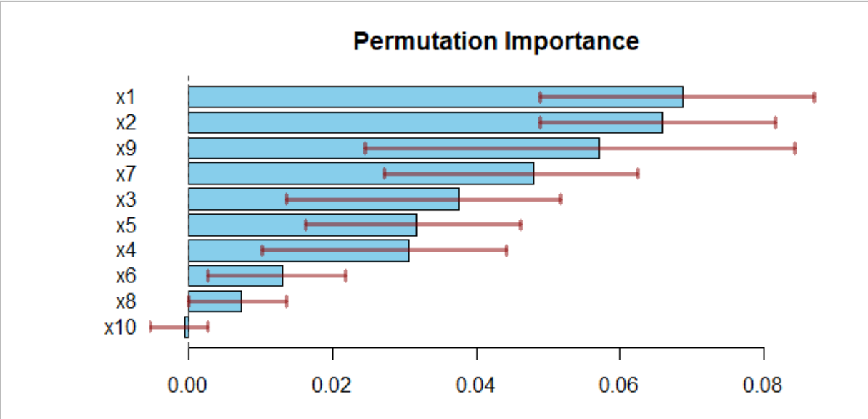
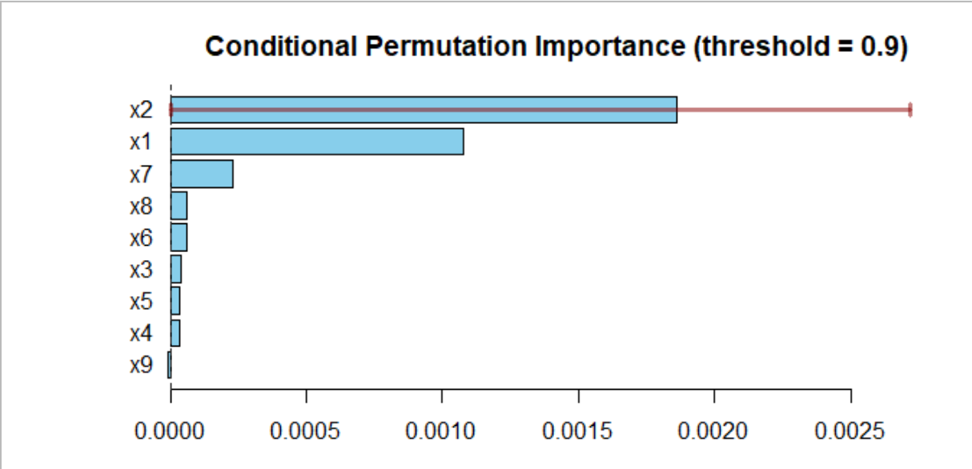
CPI vs PI for simulated dataset using permimp

Slide 29
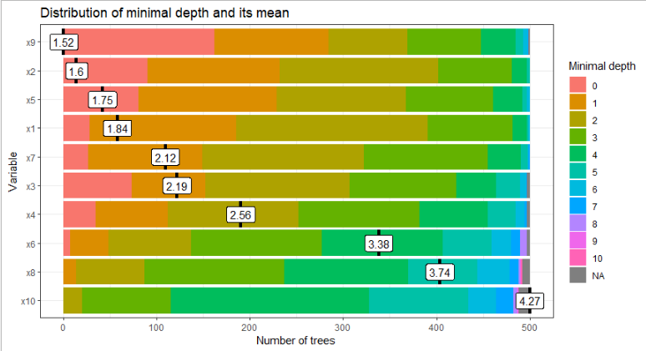
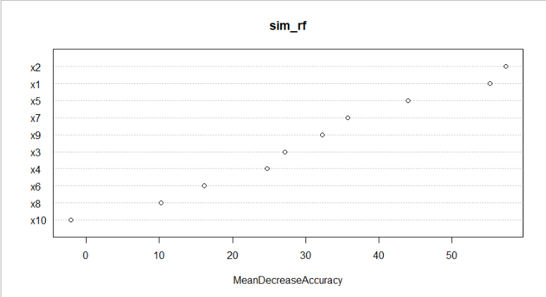
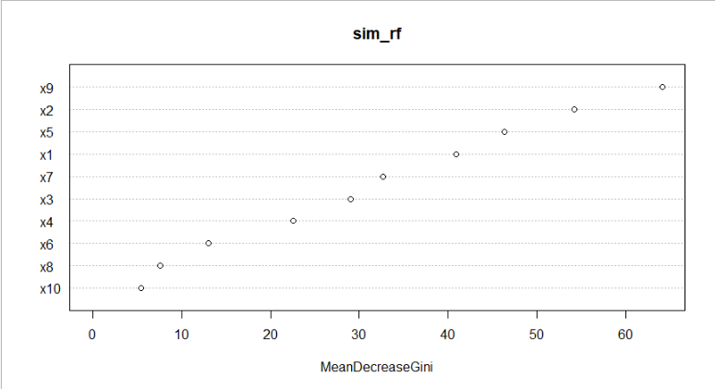
More VIMs

Slide 30
Simulated Dataset
Data is clean and prepared
High correlation between variables discovered
Found penalisation of variable importances for highly correlated attributes
1
3
5
2
4
6
randomForest and cforest models have been created
Found penalisation of variable importances for highly correlated attributes
Fine tune model or data accordingly

Slide 31
Future Work
5.
What can be done to improve our framework?

Slide 32
Other VIM techniques
Subsampling or delete-d jackknife
Surrogate Minimum Depth
Further study on determining more quantitative ways to decide what measure to pick for computing VIMs

Slide 33
Thank You!

